Slide 1
Spring Boot REST API
1

Slide 2
A RESTful API is an architectural style for an application program interface (API) that uses HTTP requests to access and use data.
Notes:
REST is an architecture for providing access to data over a network (using http protocol) through an API
Spring Boot auto-configuration automatically configures the Spring application based on the jar dependencies that we have added.
For example, if the H2 database Jar or mysql jar is present in the classpath and we have not configured any beans related to the database manually, the Spring Boot's auto-configuration feature automatically configures it in the project.
We can enable the auto-configuration feature by using the annotation @EnableAutoConfiguration. But this annotation does not use because it is wrapped inside the @SpringBootApplication annotation.
@SpringBootApplication=@ComponentScan+@EnableAutoConfiguration+@Configuration
The annotation @SpringBootApplication is the combination of three annotations: @ComponentScan, @EnableAutoConfiguration, and @Configuration.
We use @SpringBootApplication annotation instead of using @EnableAutoConfiguration.
When we add the spring-boot-starter-web dependency in the project, Spring Boot auto-configuration looks for the Spring MVC is on the classpath. It auto-configures dispatcherServlet, a default error page, and web jars.
Similarly, when we add the spring-boot-starter-data-jpa dependency, we see that Spring Boot Auto-configuration, auto-configures a datasource and an Entity Manager.
All auto-configuration logic is implemented in spring-boot-autoconfigure.jar

Slide 3
REST is an architecture for providing access to data over a network (using http protocol) through an API

Slide 4
What is REST an architecture for? REST, or REpresentational State Transfer, is an architectural style for providing standards between computer systems on the web, making it easier for systems to communicate with each other.
In REST architecture, a REST Server simply provides access to resources and REST client accesses and presents the resources.

Slide 5
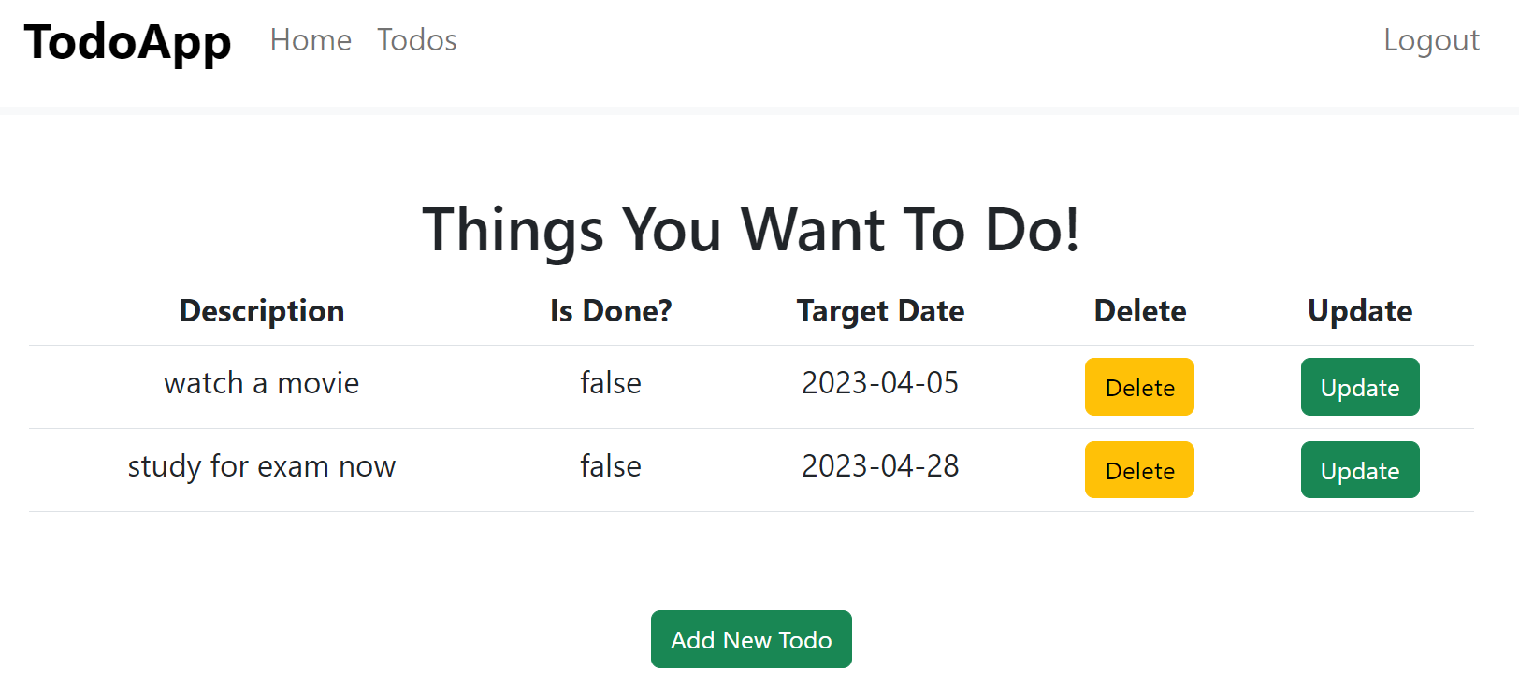
Introduction to REST
REST: Representational State Transfer
Architectural style for the web (makes use of HTTP)
Key abstraction - Resource
Todo Management Application
Examples: Users, Todos
Resource has URI (Uniform Resource Identifier)
/users/Namrata - (/users/{id})
/users/Namrata/todos - (/users/{id}/todos)
/users/Namrata/todos/1 - (/users/{id}/todos/{id})
You can perform ACTIONS on resources:
Retrieve/Add/Update/Delete Todo
Retrieve/Add/Update/Delete User
Resource can have different REPRESENTATIONS
JSON, XML (JSON - most popular)
Notes:
REST is an architecture for providing access to data over a network (using http protocol) through an API

Slide 6
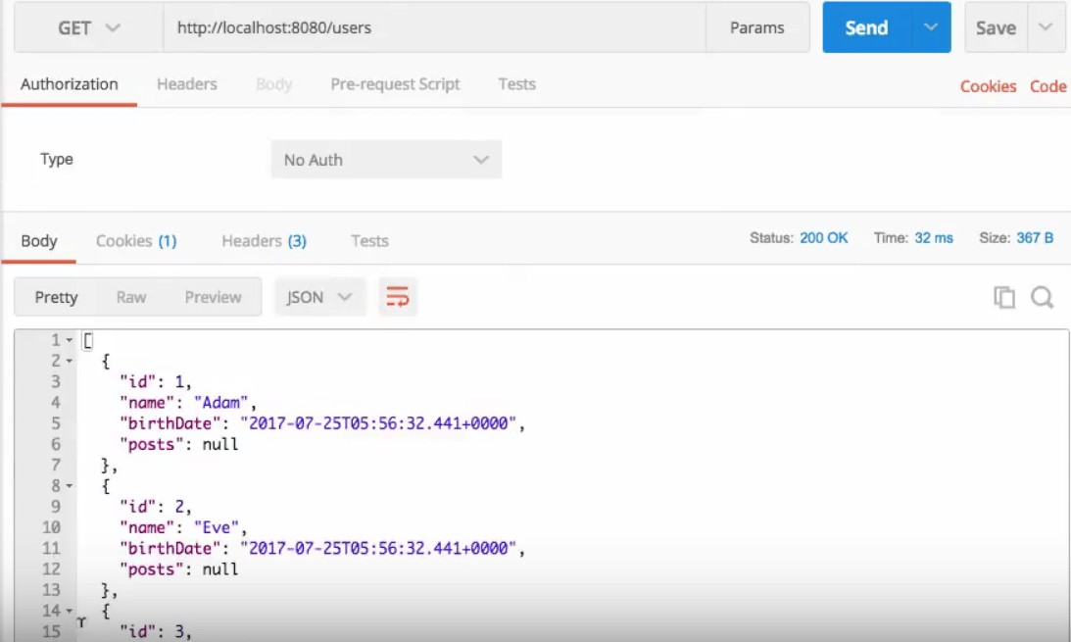
Request Methods for REST API
GET - Retrieve details of a resource
POST - Create a new resource
PUT - Update an existing resource PATCH - Update part of a resource DELETE - Delete a resource

Slide 7
Response Status for REST API
Return the correct response status
Resource is not found => 404
Server exception => 500 Validation error => 400
Important Response Statuses
— Success
— Created
204 — No Content
401 — Unauthorized (when authorization fails) 400 — Bad Request (such as validation error) 404 — Resource Not Found
500 — Server Error

Slide 8
Survey Questionnaire REST API

Slide 9
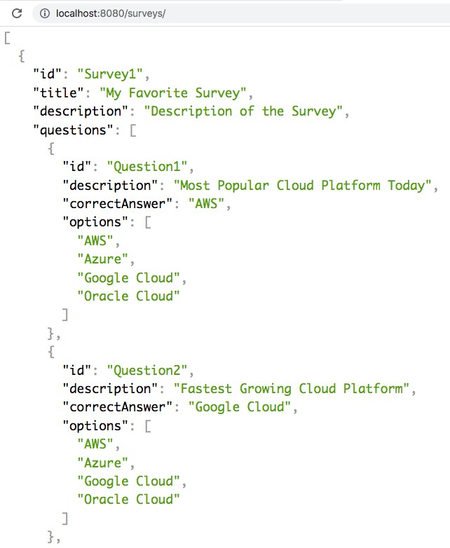
Build a REST API for Survey Questionnaire
Key Resources:
Surveys
Survey Questions
Key Details:
Survey: id, title, description, question
Survey Questions: id, description, options, correctAnswer

Slide 10
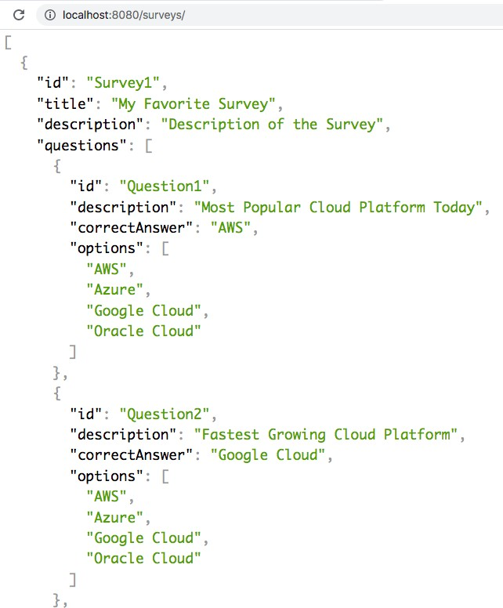
Survey Questionnaire REST API - Resources and Methods
Survey REST API:
Retrieve All Surveys
GET /surveys
Retrieve Specific Survey
GET /surveys/{surveyId}
Survey Questions REST API:
Retrieve Survey Questions
GET /surveys/{surveyId}/questions
Retrieve Specific Survey Question
GET /surveys/{surveyId}/questions/{questionId}
Add Survey Question
POST /surveys/{surveyId}/questions
Delete Survey Question
DELETE /surveys/{surveyId}/questions/{questionId}
Update Survey Question
PUT /surveys/{surveyId}/questions/{questionId}

Slide 11
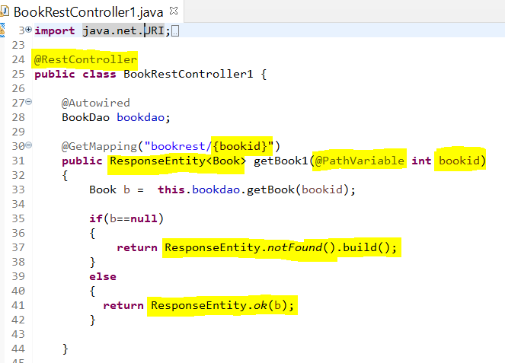
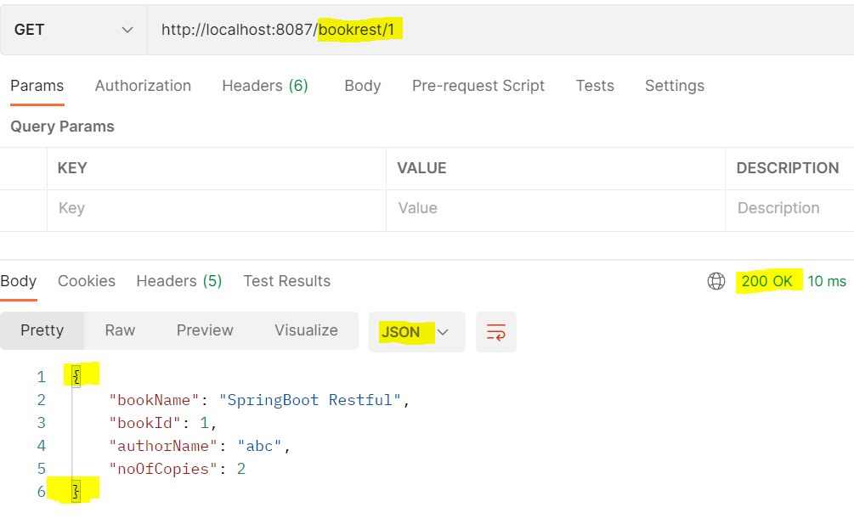
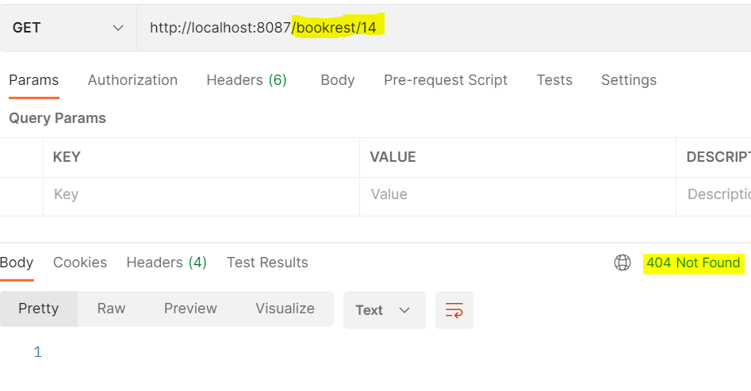

Slide 12
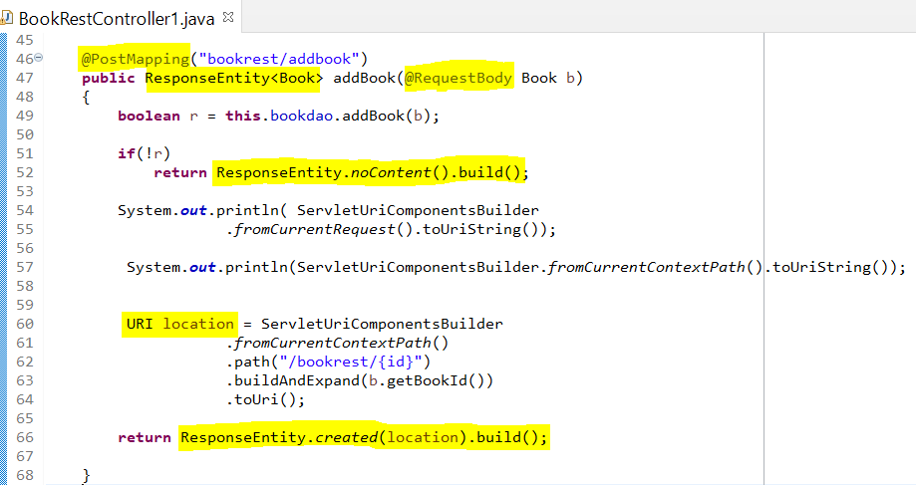
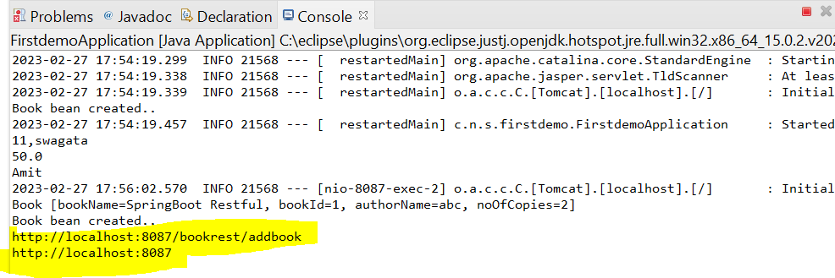
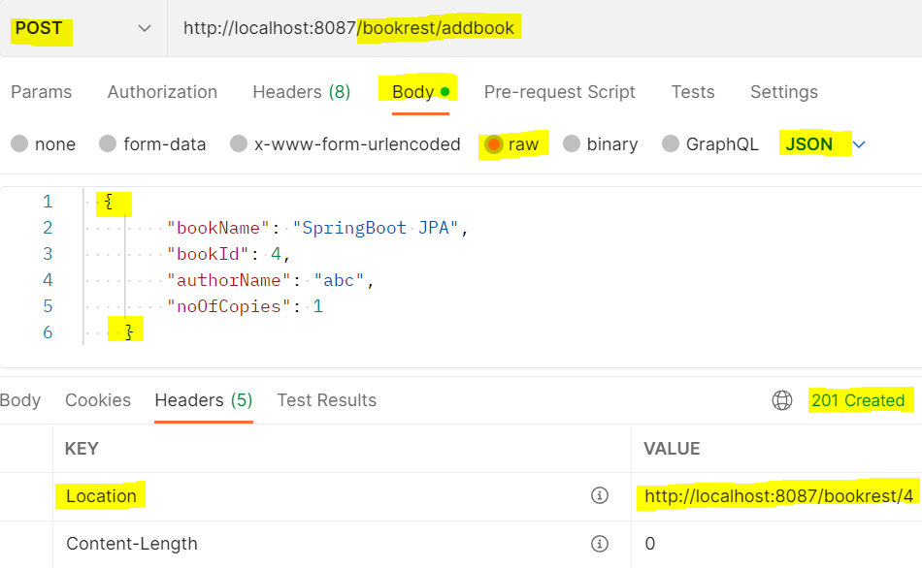
Uri string from current request path
Uri string from context path

Slide 13
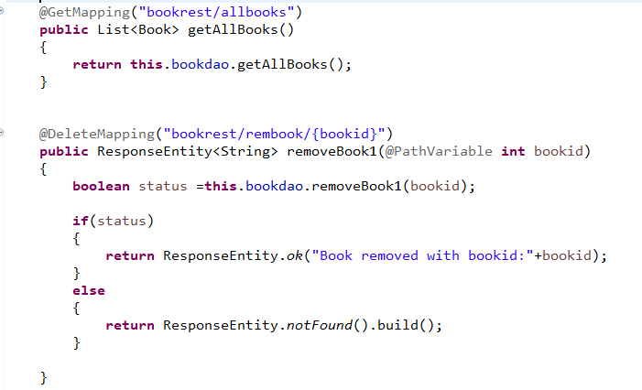

Slide 14
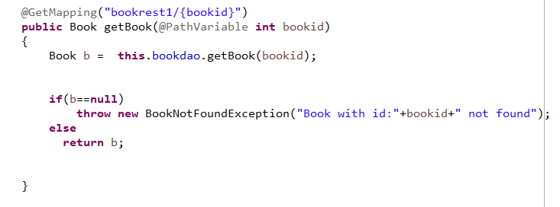
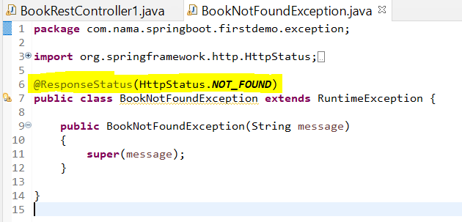
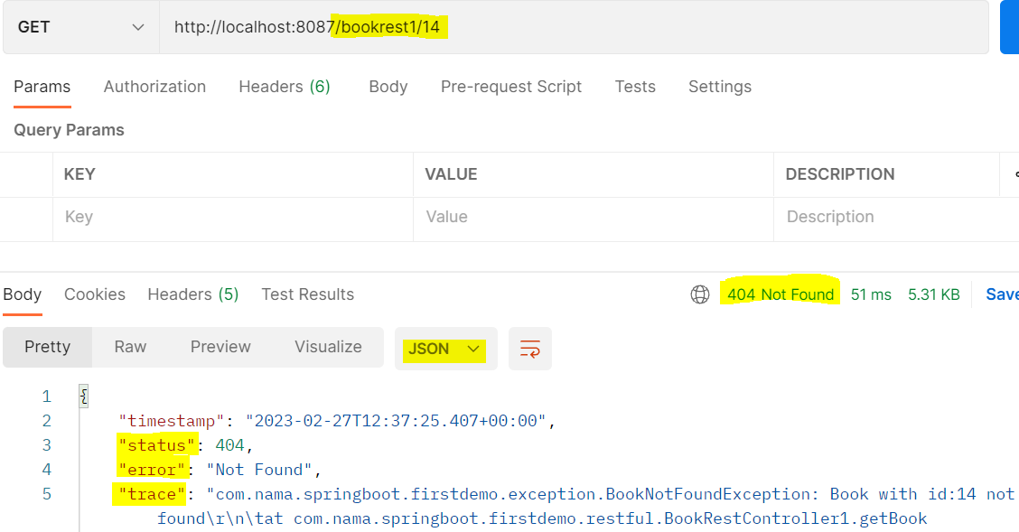
One more way to code get request by throwing exception when book is not found.. (Instead of using ResponseEntity object

Slide 15
Slides For Future

Slide 16
Constraints defined by REST
Client - Server : Server (service provider) separated from client (service consumer)
Benefits: Loose coupling, Independent evolution of server and
client (as new technologies emerge)
Each service should be stateless
Each Resource has a resource identifier
/users/Ranga - (/users/{id})
/users/Ranga/todos - (/users/{id}/todos)
/users/Ranga/todos/1 - (/users/{id}/todos/{id})
Caching response should be possible
Resource can have multiple representations
Resource can modified through a message in any of the these representations

